Slide 1
The Coca-Cola Company’s
Common Code for MQ Series
“Fast Track”
User’s Tutorial

Slide 2
Welcome to “Fast Track”
“Fast Track” is a short, quick-paced tutorial that provides all of the key information needed to transfer data files using MQ Series by IBM in a 30 minute presentation.
“Fast Track” assumes that …
  You know nothing about MQ Series.
  You need to move files in a production job at TCCC.
  The new processing was probably due YESTERDAY so …
  you have no time for anything but the essentials.
  Using the File Transfer Protocol (FTP) seems simpler and better than using
  MQ Series, and you are already familiar with using FTP.

Slide 3
The Scope of“Fast Track”
“Fast Track” covers TCCC’s custom interface to MQ Series,
which is known as the MQ Series Common Code.
“Fast Track” covers the most common usage of the Common Code,
which is:
  Cross Platform File Transfers
  Integration with a legacy application with SAP.
“Fast Track” does not discuss the Common Code’s support for:
  Management of exceptional and/or unusual conditions such as Batch Restarts
  Transactional messaging capabilities
  Usage in multiple National Settings and/or Processing Platforms.
  Various installation-specific, operational standards and processing requirements.

Slide 4
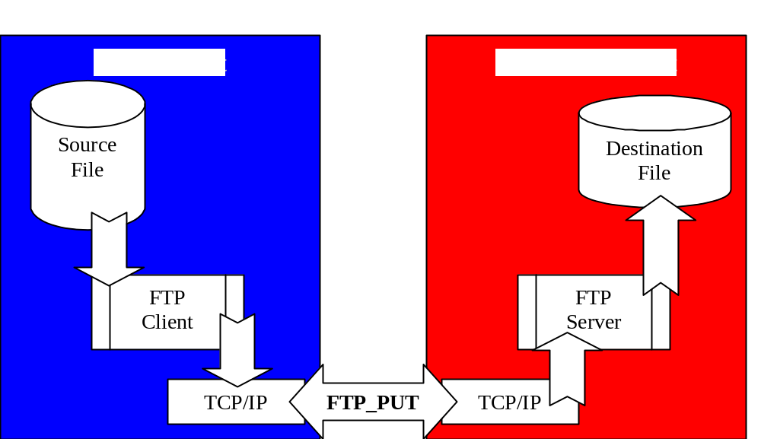
FTP File Transfers
Since we are familiar with FTP, let’s use it as a comparative basis for learning about the Common Code.
How do I transfer a file with FTP ?.
Sign-onto the
source system
Sign-on to the destination system
Use an FTP program to Issue a PUT.

Slide 5
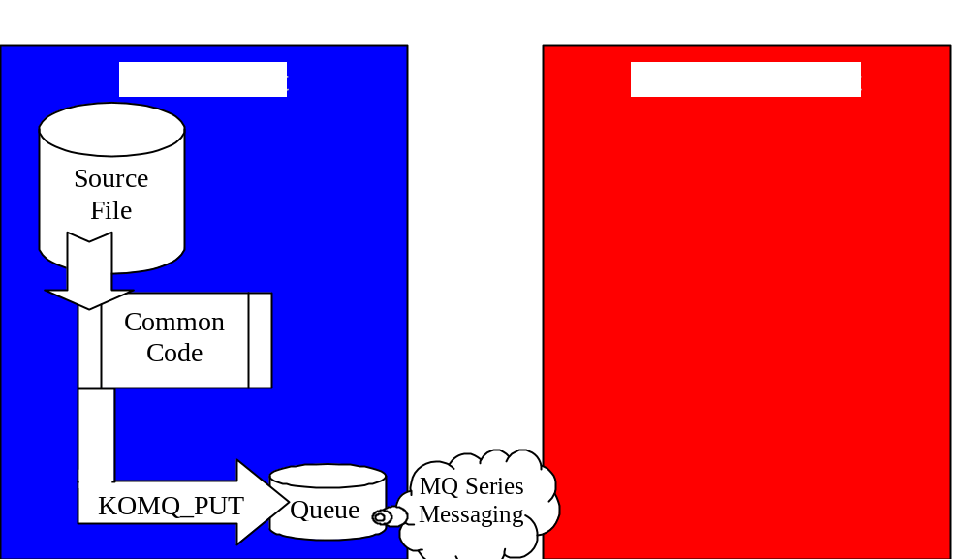
MQS Common Code File Transfers
How do I transfer a file with the Common Code for MQ Series ?.
Sign-on the source system
Use a Common Code program to Issue a PUT.
Behind the scenes a little MQ Series Messaging magic happens ...

Slide 6
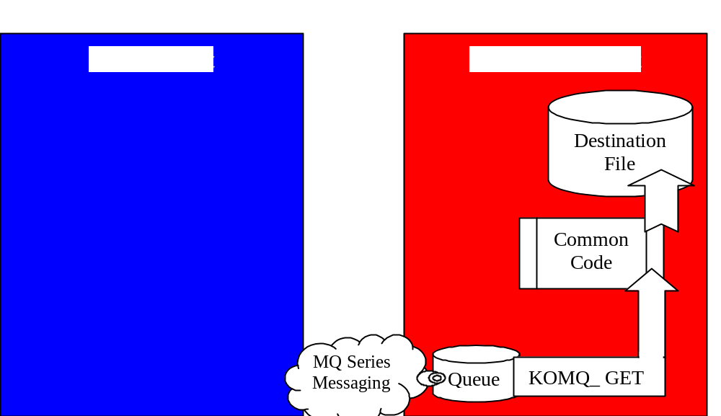
MQS Common Code File Transfers
and Then ...
Sign-on the destination system
Use a Common Code program to Issue a GET.

Slide 7
Similarities
In both cases:
No new programming is necessary for a human sender to transfer a file.
Transferring a file involves running an existing program on one computer,
which transfers a copy of the file to another computer.
A source file(s) must be created independent of the transfer process.
Specific Information is a pre-requisite for transferring a file:
  The Source machine
  The Name and Location of the Source file
  The Destination machine
Specific Access is a pre-requisite for transferring a file:
  Sign-on privileges on the Source and Destination machines
  Read access to the Source File
  Create and/or Write access to the Destination File

Slide 8
More Similarities
In both cases Automating a File Transfer process will require:
Process Design.
  Locations and Naming conventions for files on both systems ?
  How will the transfer file be created ?
  When and how frequently will the transfer process run ?
  What will trigger transferring the file ?
  What will trigger processing the file at the destination ?
  How will the transferred file be processed at the destination ?
  What are the potential failure points across the entire process ?
  How will errors be detected and resolved ?
New Programs, Scripts and/or Procedures.
  A Parameter file to hold the specifics of the process
  A Program to extract the source file
  A Script to execute the extract program and the transfer program
  Procedures for running the script and/or specifications for automated scheduling
  Procedures for resolving errors at all points-of-failure

Slide 9
Differences
File Transfer Protocol
Single Step Process
Synchronous file transfers
  All resources must be available at the same time for a transfer to occur. Senders must wait until the receiver is available and has time to complete.
No administrative pre-requisites to transfer files.
The Sender must have access to both machines.
After transmission errors, the sender must always retransmit the entire source file.
MQS Common Code
Two Step Process
Asynchronous file transfers
  Only local resources must be available for a transfer to occur. Senders can transfer files while the receiver machine is down.
Transfer resources and pathways must be predefined by administrative personnel.
The Sender needs access to only the source machine.
After transmission errors, the sender can restarting the PUT process where it left off.

Slide 10
Comparative Summary
File Transfer Protocol
Simplest possible approach
Implements somewhat more quickly
  No administrative coordination required
Is better suited for usage in
ad-hoc and non-automated scenarios
MQS Common Code
Is the most robust and fault tolerant approach for data transfers within automated processing.
  Assures deliver at the destination.
  Provides automated balancing.
  Provides National Language Support for International Users.
Is required by TCCC for all integration with SAP.

Slide 11
Common Code Specifics
MQS Common Code was specifically designed to:
  Simplify SAP integration with Legacy systems.
  Capitalize on our familiarity with using files for inter-system integration.
  Minimize the custom development necessary to integrate with SAP
MQS Common Code fulfills those design specifications by:
  Handling all of the details involved in separating the records of a file into a series of independent messages.
  Transferring those messages asynchronously through a network and determining when they have all arrived.
  Correctly reassembling messages in sequence, back into a single file on the destination machine.
  Accompanying your data file with a control file to enable verification on the destination system that ALL RECORDS of the ENTIRE file have been transferred, and providing an Automated Balancing facility in its transfer program.

Slide 12
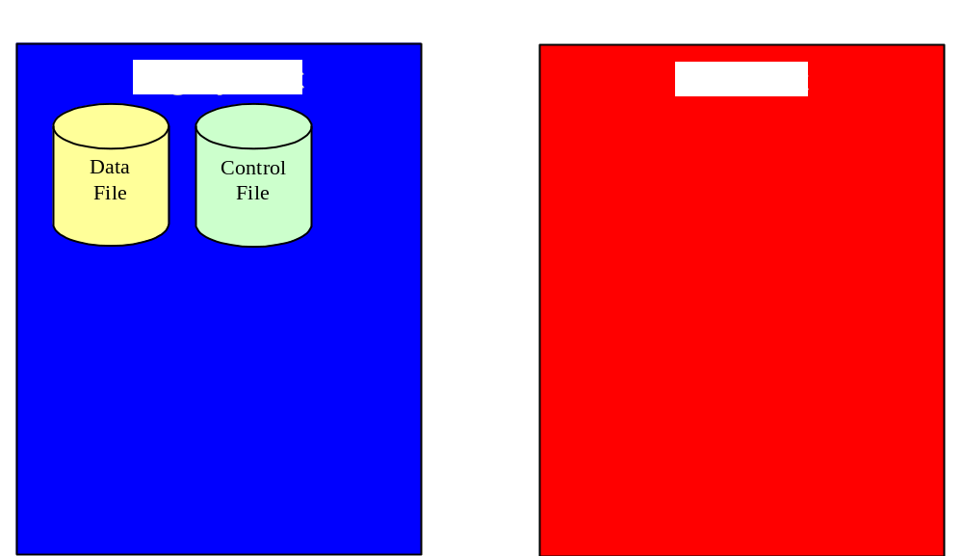
The Details of MQS Common Code
Now, lets take a look at how the MQS Common Code actually works!
The sender extracts a data file from the legacy system
The sender also constructs a control file, which contains a single record with a count of the records in the data file.

Slide 13
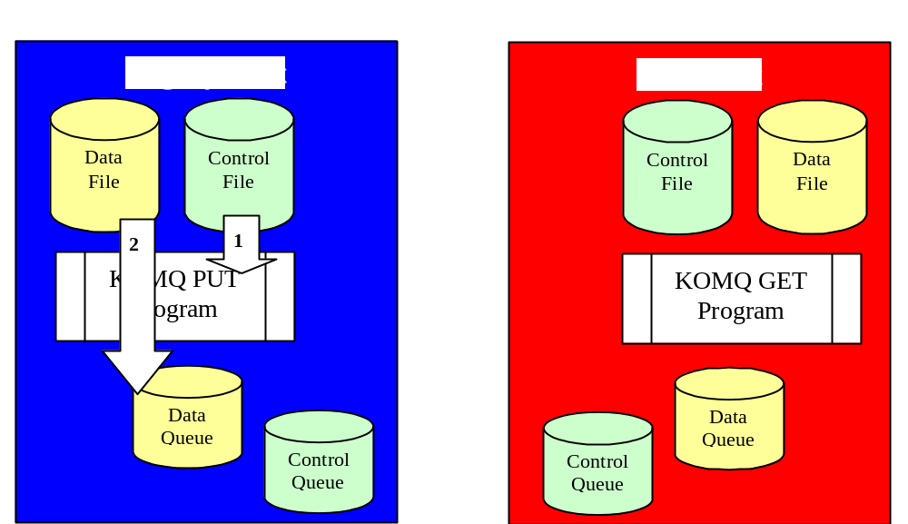
The Details of MQS Common Code
MQS Common Code PUT Program (KOMQPUT) is run.
KOMQPUT reads the control total from the control file

Slide 14
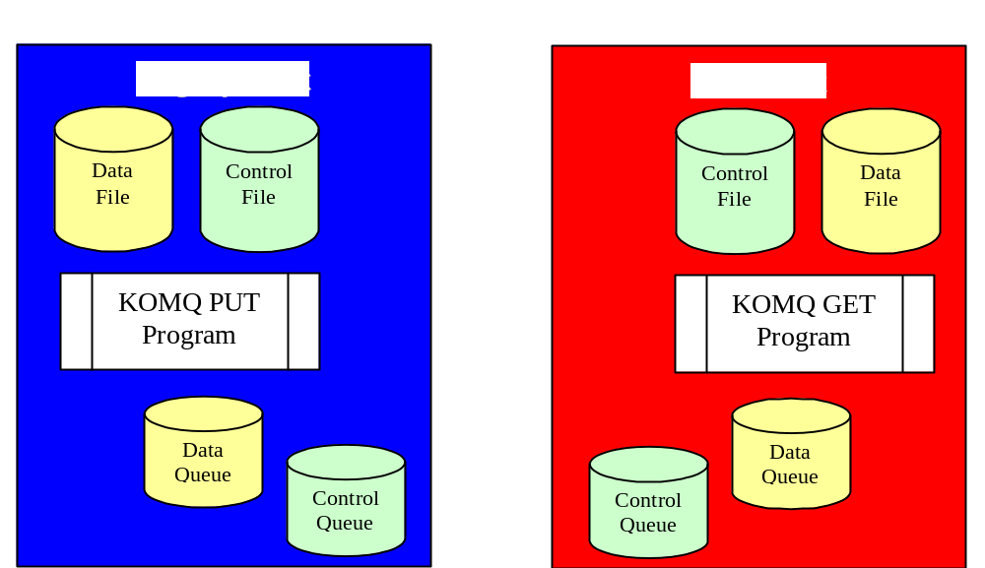
The Details of MQS Common Code
The sender extracts a data file from the legacy system
The sender also constructs a control file, which contains a single record with a count of the records in the data file.

Slide 15
The Details of MQS Common Code
The sender extracts a data file from the legacy system
The sender also constructs a control file, which contains a single record with a count of the records in the data file.

Slide 16
The Details of MQS Common Code
The sender extracts a data file from the legacy system
The sender also constructs a control file, which contains a single record with a count of the records in the data file.

Slide 17
The Details of MQS Common Code
The sender extracts a data file from the legacy system
The sender also constructs a control file, which contains a single record with a count of the records in the data file.

Slide 18
Steps to using MQS Common Code
Analyze and Design the Integrated Transfer Process
  Request a copy of the MQS Common Code User’s Documentation
  Determine the Source and Target Systems
  Establish Application Naming Conventions
    Queues
    Batch Headers
  If multiple file formats are to be transferred …
    Establish a Queue Utilization Approach
  Establish a File Management Approach
    How will multiple file formats be segregated
    Establish a File Archiving/Removal strategy
  Establish the related Volumetric and Scheduling Information
    Maximum number of records in a file
    Record length of the files.
    Queue Depth requirements.
    Transfer frequencies.

Slide 19
Steps to using MQS Common Code
Request Definition of Queues
  Use the request forms from the User’s Documentation Appendix
  Request definition of Queues
    Separate requests for both Source and Destination machines.
      Request a “Remote” queue definition for the Source machine
      Request a “Local” queue definition for the Destination machine
    Request a separate set of Queues for each transfer direction.
      Queues are uni-directional.
      A bi-directional data flow requires a separate queue for each transfer direction.
    Send requests to the MQ Series support team for the specific platform.
      OS/390 Isaiah Rosenblit
      AS/400 Scott Murray
      AIX Debbie Granger

Slide 20
Steps to using MQS Common Code
Prepare Your Parameter Files
  Determine the common processing Parameters
    Does the record length necessitate blocked file processing?
    I/O Buffer Length
    Batch Interval
  PUT processing Parameters
    Queue Manager Name
    Queue Names for the Sending Machine
    File Names and locations for the Sending Machine.
    Batch Header value for each File Format.
  GET processing Parameters
    Queue Manager Name
    Queue Names for the Receiving Machine
    File Names and locations for the Receiving Machine.
    Must NOT contain a BATCH HEADER keyword.
  Dead Letter processing Parameters
    Queue Names for the Sending Machine
Note: Queue Names may or may not correspond between the sending and the receiving machines.
The relationship between queues is established by definition not by naming conventions.

Slide 21
Steps to using MQS Common Code
Prepare a Script for PUT, GET and Dead Letter processing.
  A script defines the actual invocation of the transfer program as well as any
  pre/post transfer processing that is necessary.
    Each platform refers to these scripts using different nomenclature
      OS/390 JCL, PROCs, CLISTS, and REXX
      AS/400 CL, and REXX
      Windows Batch files (.BAT), Perl, VBScript, Jscript, Host Scripting
      Unix / AIX Korn Script, Bourne Script, and Perl
Unit test all of your scripts.
From your failure point analysis, construct a comprehensive integration test plan.

Slide 22
Steps to using MQS Common Code
Conduct a technical walk-through in which you review your:
(If possible, it is recommended that you include the MQS Common Code support staff.)
  Parameter Files
  Scripts
  Failure Point Analysis
  Test Plans
Execute your test plan.
Prepare and execute an implementation plan.

